Slide 1
Tree-Based Information Retrieval System
Alexandria Persing
BSCS

Slide 2
What is an Information Retrieval System?
Measurements: Recall and Precision
Definitions
How does mine work?
Content Tree
Building a Document Profile
Comparing Documents
Results and Iterations
Rewriting Comparison Algorithm
Generating Content Trees

Slide 3
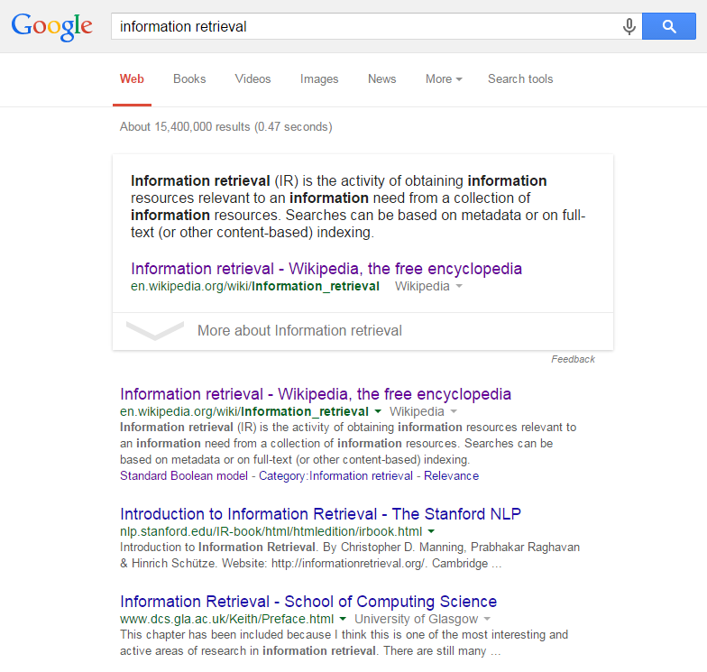
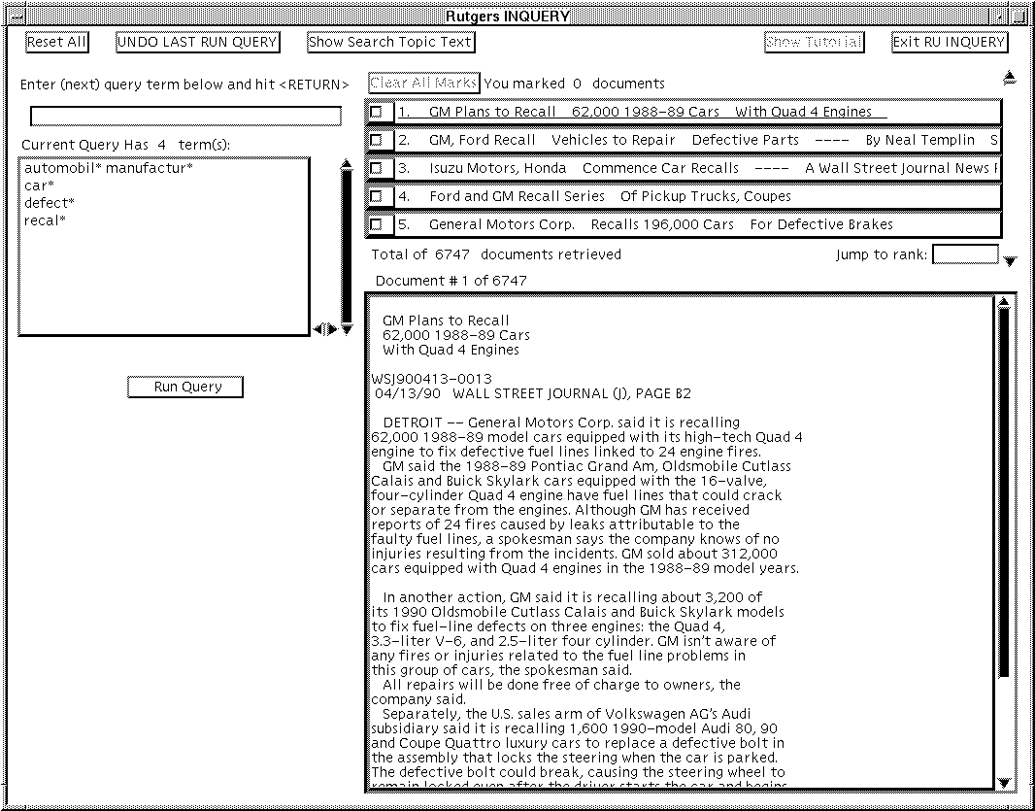
What is an Information Retrieval System?

Slide 4
Recall and Precision
Measurements for determining how well the system works
Recall:
What percentage of the correct documents were actually retrieved?
= Number of relevant documents retrieved / Total number of relevant documents
Precision:
What percentage of the retrieved documents were correct?
= Number of relevant documents retrieved / Total number of retrieved documents

Slide 5

How does mine work?
Based on the idea of there being “Content Trees” from which document profiles are built
You then compare the document profiles to determine similarity

Slide 6
Content Tree Example
All
Animals
Pets
Zoo
Food
Farm
Beef
Cooking
Cookie

Slide 7
Building a Document Profile
I like farms because they produce lots of food, including my favorite, beef.
All
Animals
Pets
Zoo
Food
Farm
Beef
Cooking
Cookie
All
Animals
Food
Farm
Beef
2
1
1
1
1

Slide 8
Comparing Profiles
All
Animals
Food
Farm
Beef
All
Animals
Food
Farm
Cooking
Beef
All
Animals
Government
Pets
Laws
2
1
2
1
1
3
1
1
1
1
1
1
2

Slide 9
Initial Results
Using the TIME Collection of articles
 | Avg. Precision | Avg. Recall
First Results | .091 | .095
After Word Stemming | .067 | .085
Well, this isn’t working very well…
 | Avg. Precision | Avg. Recall
Document vs. Document | .274 | .194

Slide 10
Rewriting the Algorithm
There is an underlying issue with this model where profiles built from queries have different weighting for each branch, because queries only contain the words which they need to be relevant to the searcher’s needs
Therefore, I put in an “Error Margin” in the comparison algorithm, which allowed me to still include documents which were pretty similar, but may have otherwise been excluded because they’re not exactly like the query
 | Avg. Precision | Avg. Recall
Query vs. Document | .189 | .14

Slide 11
Generating Content Trees – Why?
Originally, each tree used for testing was made by hand
This could be tedious, and oftentimes there were documents which should in theory be matched by the system, but weren’t because there were no words in the tree to properly convey their meaning
 | Avg. Precision | Avg. Recall
Original Tree | .032 | .484
After adding words | .044 | .449
A later iteration | .138 | .462
After adding words | .142 | .417

Slide 12
Generating Content Trees
Using the Inverse Document Frequency
IDF = ln( (Total number of documents) / (Number of documents in which the word appears) )
A tree is then generated by adding words one at a time in order of IDF such that every word has children which appear in a subset of the documents the word itself appears in

Slide 13
Generating Content Trees: Example
Word | Documents in which it appears | IDF Score
Food | 1, 2, 3, 4, 5 | Ln(10/5) = .69
Beef | 1, 2, 3 | Ln(10/3) = 1.2
Steak | 1, 2 | Ln(10/2) = 1.6
Hamburger | 2, 3 | Ln(10/2) = 1.6
All
Food
Beef
Hamburger
Steak

Slide 14
Results After Generating Content Tree
 | Avg. Precision | Avg. Recall
Query vs. Document | .132 | .512

Slide 15
Questions?

